Slide 1

OOM Project
N SQUARE
Under
OP Vyas Sir & Bagesh Kumar Sir

Slide 2
GROUP MEMEBERS
Name | Roll Number
Challa Lahari | IIT2020083
Bhupathi Smaran | IIT2020168
Vaishnav Kamarti | IIT2020192
Nitheesh | IIT2020234

Slide 3


Abstract of the project
We had to create a 9-box puzzle game Software
A nine box puzzle game consists of nine boxes that are labeled from one to eight. Player needs to arrange the labeled boxes serially.
The game counts the number of attempts by the player. A player with the minimum number of attempts is the winner of the game
The puzzle game also accepts the name of the player and keeps track of the Players performance.

Slide 4
Our Approach to the PROJECT
Home Screen will redirect the Player to desired -> MainView extends JPanel.
Game board will have 8 buttons -> Box extends JButton.
Box will be clicked , so to listening that event -> EventHandler extends action Listener (with Sound / Other Animation ).
We needed a panel to hold boxes and display swaps -> PlayArea extends JPanel.
We needed a Brain for the Game, that will keep track of algorithm , it will initialise , it will validate moves (right or not) -> GameCPU
We also had to track Player name and score, we stored it in an Arraylist -> ScoreBoard extends JPanel
But each player data is unique -> PlayerData
What if someone does not know how to play game -> Rules extends JPanel

Slide 5
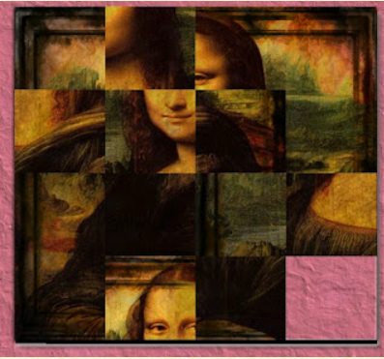
What if we wants to extend the project
We can increase the number of boxes to N^2 ( 16,25,36……..)
We can extend number puzzle to picture puzzle.
11 | 5 | 13 | 10
6 | 1 |  | 3
15 | 4 | 8 | 14
7 | 12 | 2 | 9
8 | 1 | 3
4 |  | 7
5 | 2 | 6

Slide 6
What is UML diagram?
It is based on diagrammatic representations of software components.
UML diagrams can be used as a way to visualize a project before it takes place or as documentation for a project afterward. But the overall goal of UML diagrams is to allow teams to visualize how a project is or will be working, and they can be used in any field, not just software engineering.
Purpose
Visualize
Development
Maintenance

Slide 7
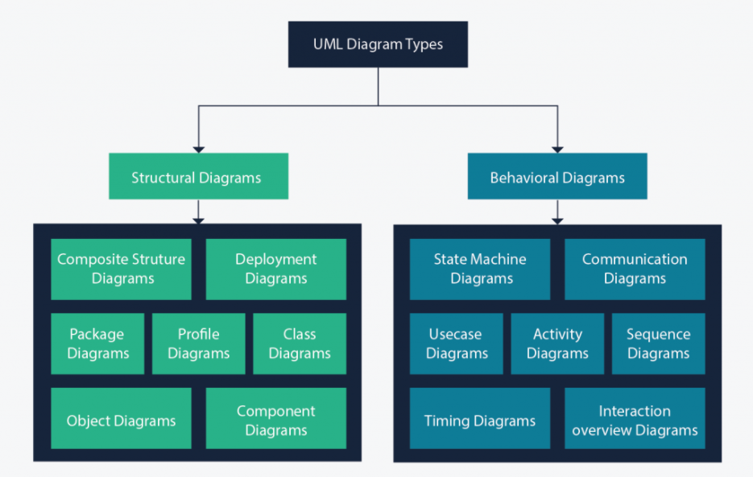


Structure diagrams show the static structure of the system and its parts on different abstraction and implementation levels and how they are related to each other. Behavioral diagrams show what should happen in a system. They describe how the objects interact with each other to create a functioning system.

Slide 8
Class diagram
The class diagram is a central modeling technique that runs through nearly all object-oriented methods. This diagram describes the types of objects in the system and various kinds of static relationships which exist between them. Class diagram also shows the attributes and operations of a class
There are three principal kinds of relationships which are important :
Relationship
Association
Aggregation
Composition
Inheritance

Slide 9
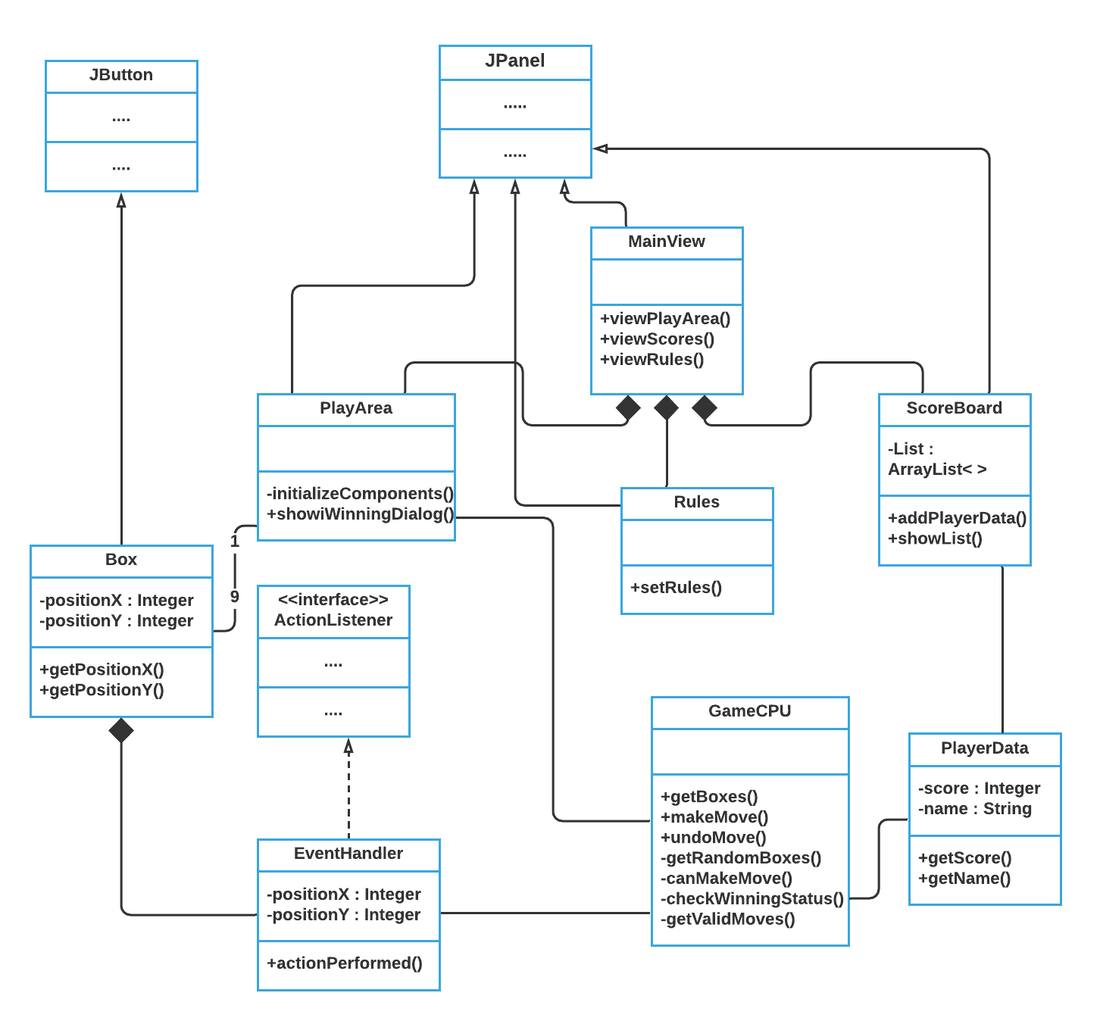
The Puzzle Box class diagram

Slide 10
USE CASE diagram
Use case diagram can summarize the details of your system's users and their interactions with the system. To build one, you'll use a set of specialized symbols and connectors. An effective use case diagram can help your team discuss and represent the following :
Scenarios in which your system or application interacts with people, organizations, or external systems
Goals that your system or application helps those entities (known as actors) achieve
Characteristics
Describes one main flow of events (main scenarios) and possibly other exceptional flows (alternatives)
Organizes functional requirements
Models the goals of system / actor (user) interactions

Slide 11
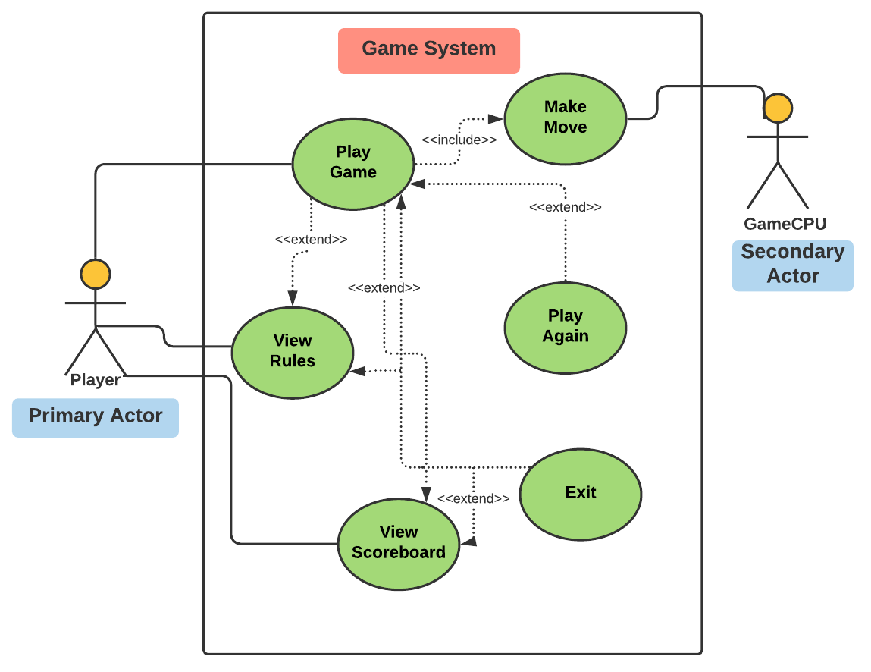
The Puzzle Box Use- Case diagram :

Slide 12
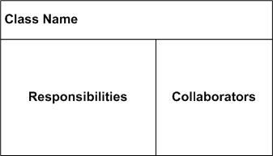
Class Responsibility Collaborator CRC DIAGRAM
A Class Responsibility Collaborator (CRC) model is a collection of standard index cards that have been divided into three sections, A class represents a collection of similar objects, a responsibility is something that a class knows or does, and a collaborator is another class that a class interacts with to fulfill its responsibilities.

Slide 13
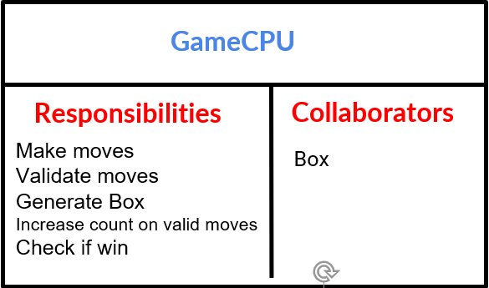
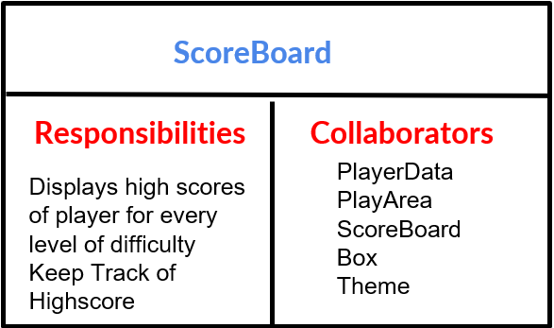
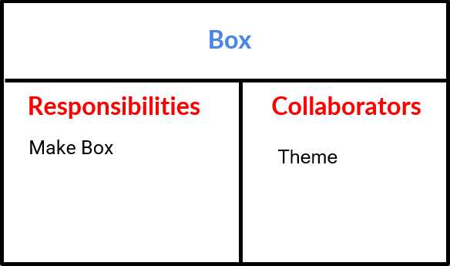
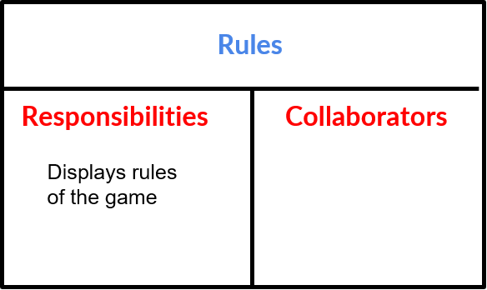

Slide 14
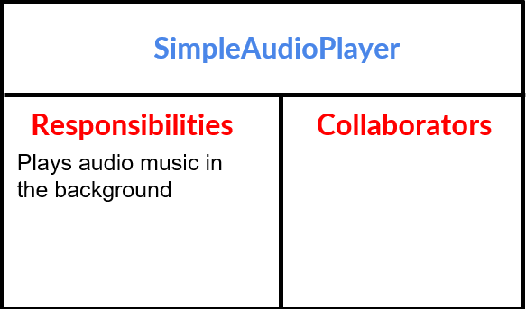
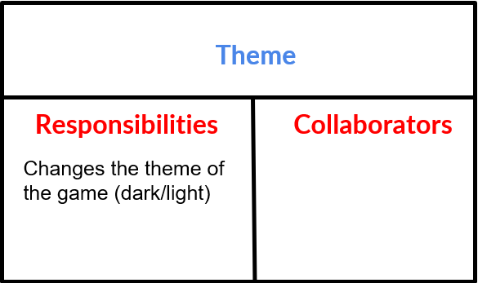
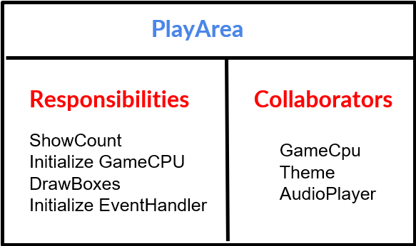
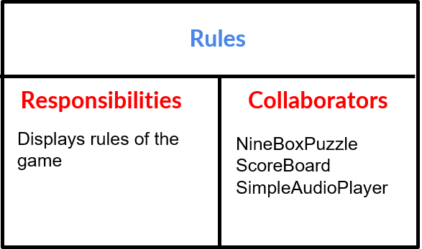

Slide 15
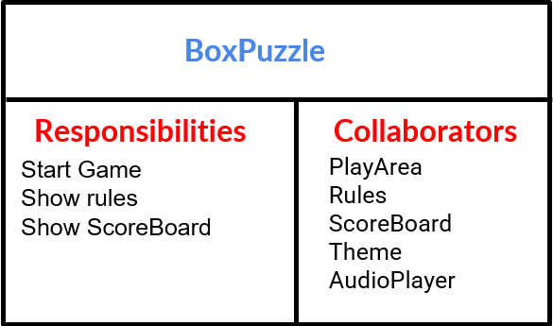
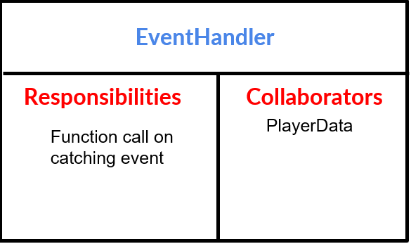
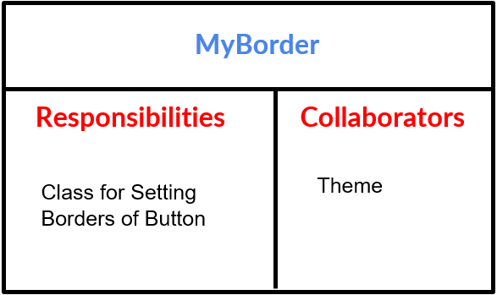

Slide 16
PuzzleBox Class
JMenuBar
JMenuBar menubar = new JMenuBar();
JMenuOptions
JMenu options = new JMenu("Theme");
JMenuItem darkTheme = new JMenuItem("Dark Theme");
darkTheme.addActionListener(
new ActionListener(){
@Override
public void actionPerformed(ActionEvent e)
{
//Change Theme
}});
GridBagLayout
setLayout(new GridBagLayout());//Setting layout
GridBagConstraints gridBagLayout = new GridBagConstraints();// we have to do this to add it to container
gridBagLayout.fill = GridBagConstraints.BOTH;
gridBagLayout.anchor = GridBagConstraints.CENTER;
gridBagLayout.ipady = 20;
gridBagLayout.ipadx = 40;
gridBagLayout.gridwidth = 1;
gridBagLayout.gridheight = 1;
gridBagLayout.insets = new Insets(10,10,10,10);

Slide 17
PuzzleBox Class
JButtons
JButton ruleButton = new JButton("rule"); //Rules or PlayGame or Scores or Exit
ruleButton.setOpaque(false);
ruleButton.setContentAreaFilled(false);
ruleButton.setBorderPainted(false);
JLabel I7 = new JLabel("");
l7.setIcon(imageIconPath("Rules"+theme)); //Setting Theme
l7.setPreferredSize(new Dimension(100, 100));
ruleButton.add(l7);
ruleButton.addActionListener(new ActionListener()
{
//Change Panel to Rules or PlayGame or Scores or Exit
}});
ruleButton.setFont(new Font("Dialog", Font.PLAIN, 40));
gridBagLayout.gridx = 0;
gridBagLayout.gridy = 2;
add(ruleButton, gridBagLayout);

Slide 18
PlayArea Class
Initialise
private void initializeComponents(int n) {
setLayout(new GridLayout(n, n));
Box[][] boxes = mygamecpu.getBoxes();
for (int i = 0; i < n; i++) {
for (int j = 0; j < n; j++){
add(boxes[i][j]);
boxes[i][j].addActionListener(new EventHandler(mygamecpu, i, j));
}
}
setVisible(true);
}
Moves Setter
protected void setCount(int movesCount) {
score.setText("Moves Count : " + movesCount);

Slide 19
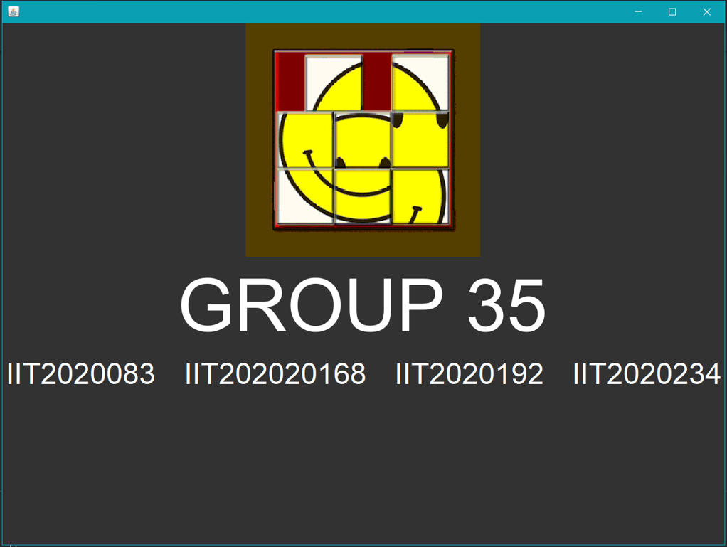
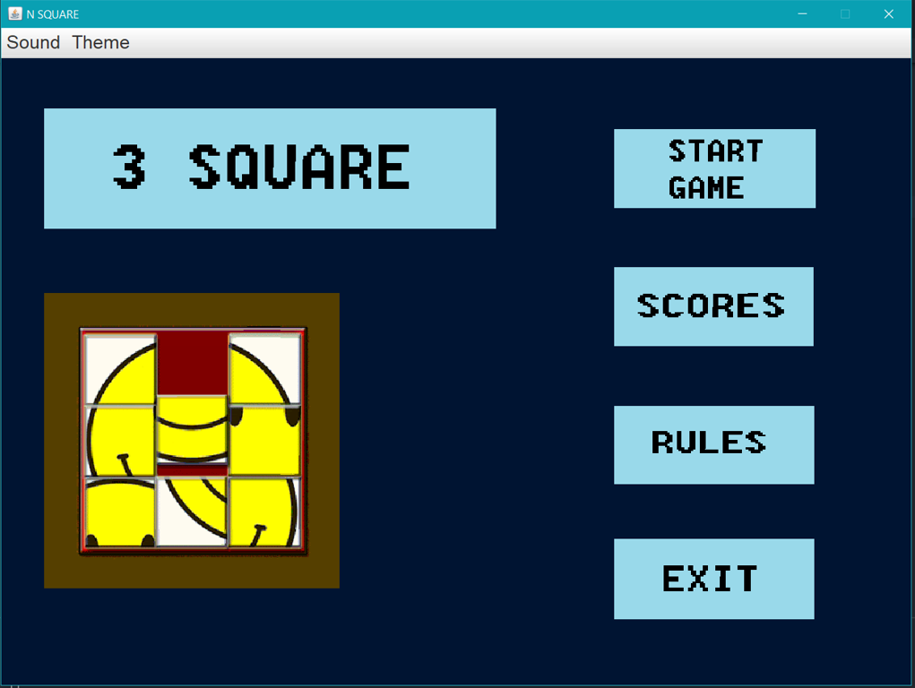
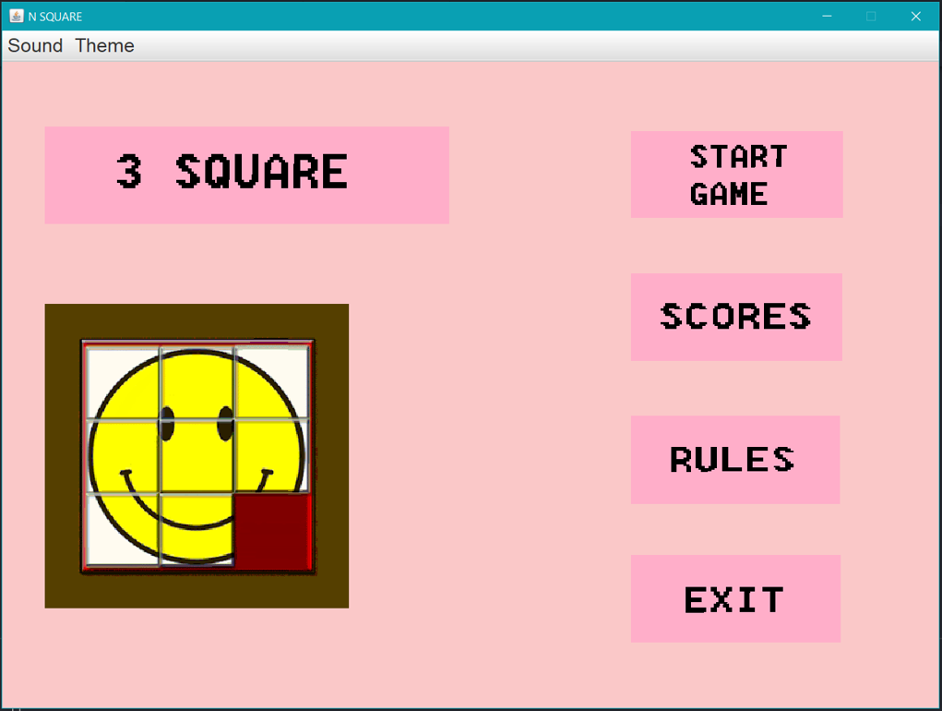

Slide 20
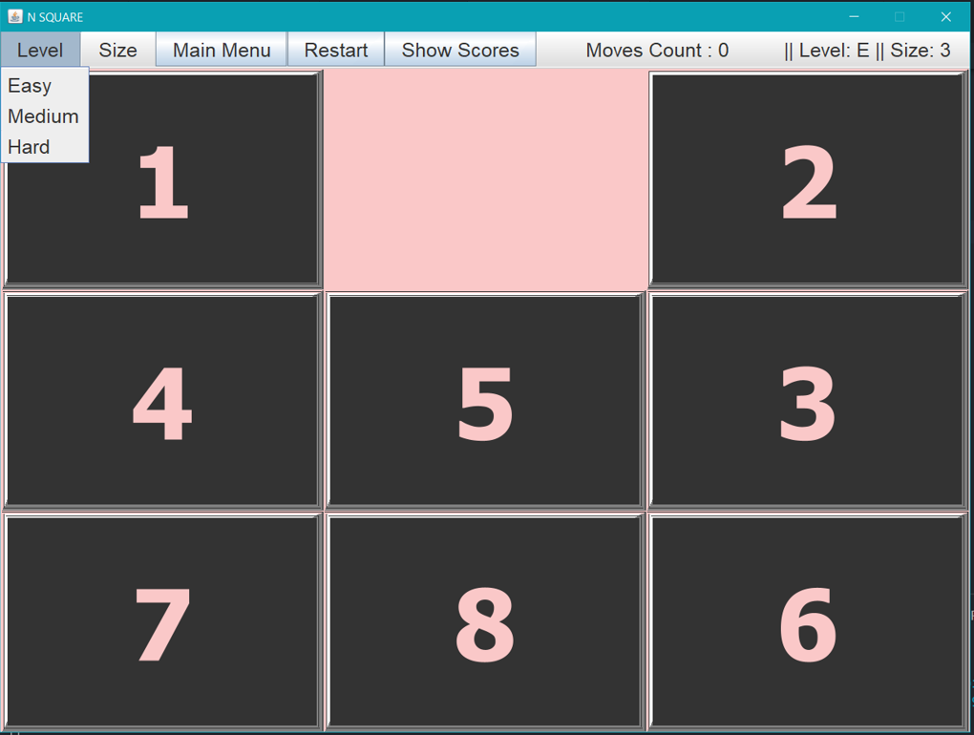
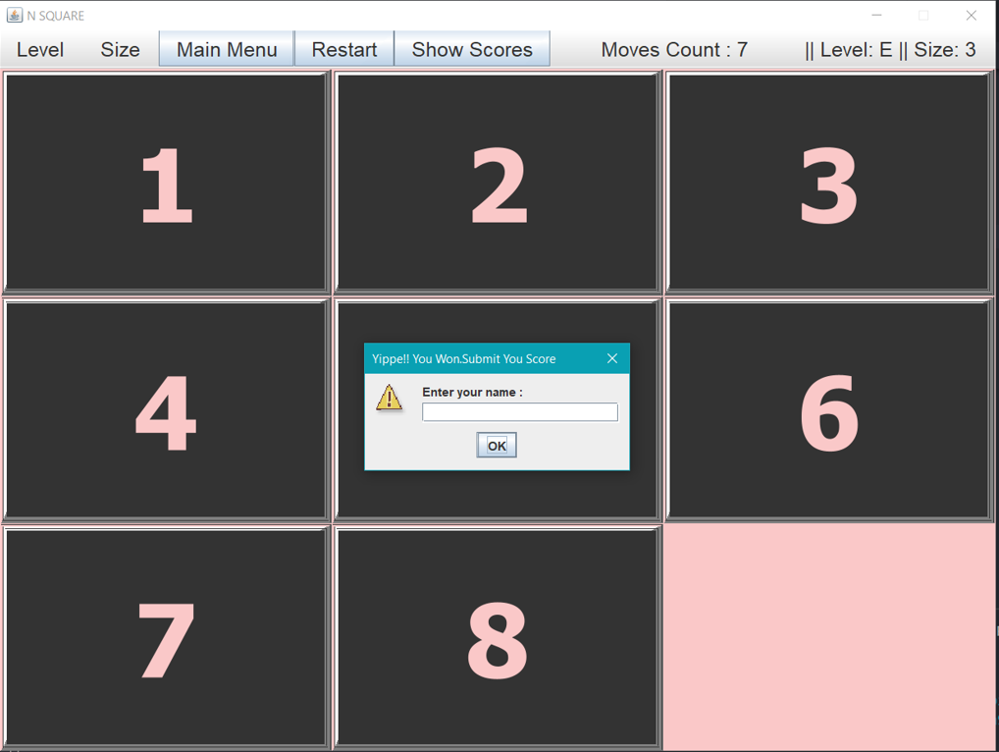
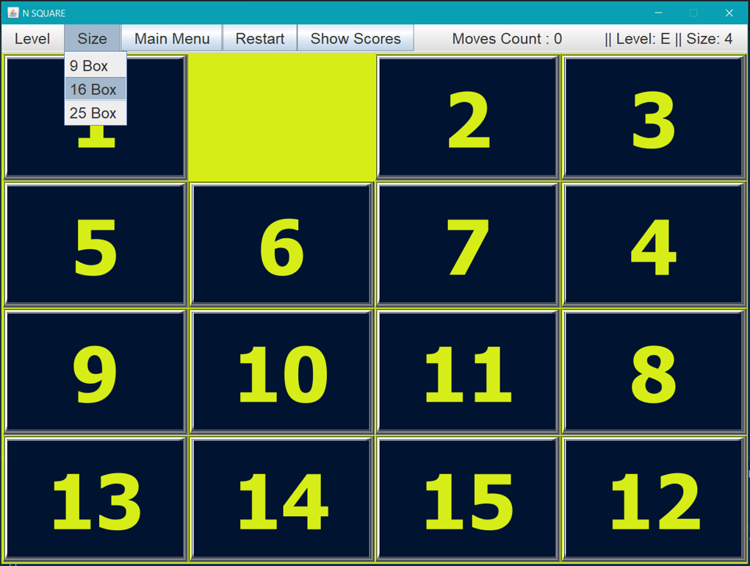

Slide 21
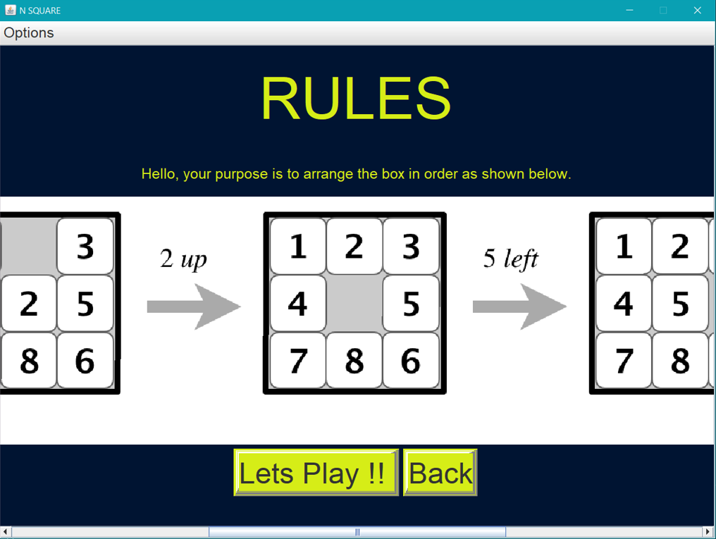
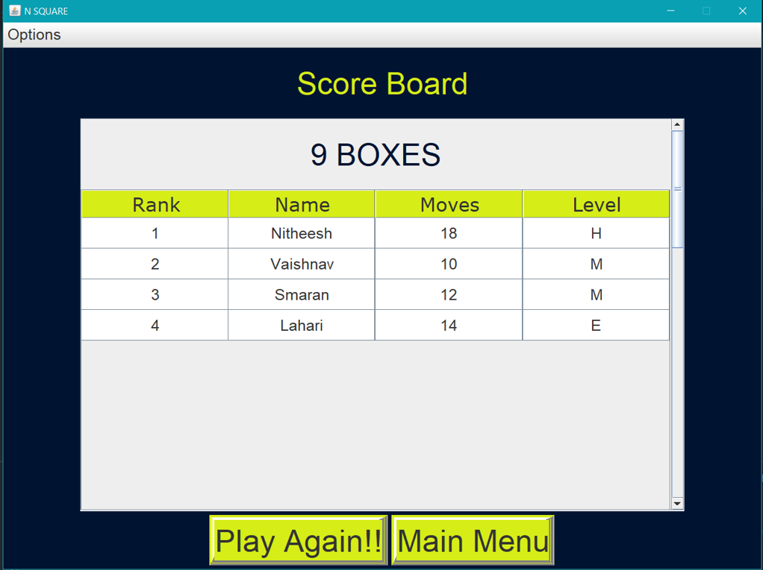

Slide 22


Group-35

